Slide 1

Retail Store Analysis Report
Abdelrahman Ashour

Slide 2
Agenda
Introduction
Sales Performance Analysis
Products Performance Analysis
Conclusion
Q&A Session
Presentation Title

Slide 3

Introduction
This presentation aims to analyze retail sales metrics and provide insights into Sales and product performance across categories.
It includes two main dashboards:
the Sales Performance Dashboard, focusing on sales trends and order priorities across devices, and the Products Performance Dashboard, highlighting sales by gender, categories, and top products.
Understanding these metrics is crucial for optimizing sales strategies and identifying growth opportunities in the retail sector. Key metrics covered include total sales, profit, order priorities, product categories, and top-selling products.

Slide 4
Sales Performance Dashboard Analysis
Dashboard Overview
Key Visuals and Metrics
Insights and Observations
Recommendations for Sales Improvement

Slide 5
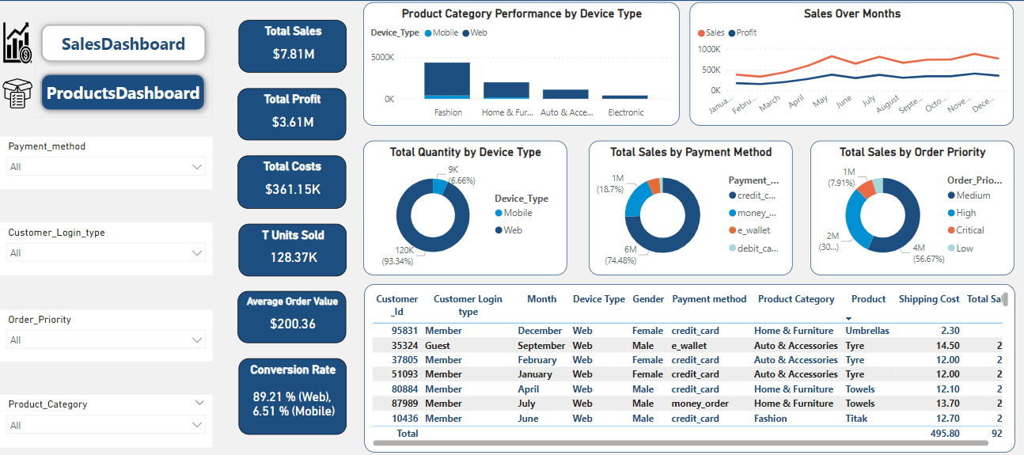
Sales Performance Dashboard Analysis

Slide 6
Sales Metrics Interpretation
Insight: Strong overall sales performance, indicating healthy demand for products.
Recommendation: Analyze sales trends to identify peak periods and adjust marketing strategies accordingly. Explore opportunities to expand into new markets or product categories.
Insight: High volume of units sold, suggesting efficient inventory management and popular product selection.
Recommendation: Investigate which specific products are driving unit sales. Consider promotional campaigns or bundles for top-selling items to further boost sales volume.
$7.81M
Total Sales
128.37K
Total Units Sold
Insight: Healthy profit margin, demonstrating effective pricing and cost control strategies.
Recommendation: Analyze profit margins by product category or sales channel to identify areas for optimization. Consider exploring ways to increase average order value to boost profitability.
Insight: Relatively high average order value, indicating customers are purchasing multiple items or higher-priced products.
Recommendation: Encourage upselling and cross-selling through personalized product recommendations and targeted promotions. Implement loyalty programs to reward repeat customers and increase their spending.
$3.61M
Total Profit
$200.36
Avg Order Value(AOV)
$361.15K
Total Costs
89.21 %(Web),
6.51 %(Mobile)
Insight: Costs are well-controlled relative to sales and profit, contributing to a healthy financial performance.
Recommendation: Continuously monitor costs to identify potential areas for further optimization. Explore opportunities to negotiate better deals with suppliers or streamline operational processes.
Conversion Rate
Insight: Significant disparity in conversion rates between web and mobile channels, indicating a need for improvement in the mobile experience.
Recommendation: Optimize the mobile website for user experience, ensuring easy navigation and fast loading times. Invest in mobile-specific advertising and promotions to drive traffic and conversions through this channel.

Slide 7
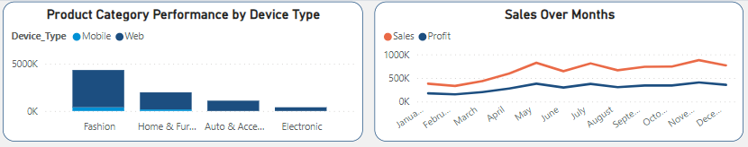
Product Category & Channel Performance
Insights:
Web sales significantly outperform mobile sales across all product categories.
"Fashion" is the top-performing category overall, with a strong web presence but minimal mobile sales.
Mobile sales are relatively low across all categories, indicating untapped potential for growth.
Recommendations:
Optimize Mobile Experience: Prioritize improving the mobile website or app to boost mobile conversion rates.
Tailor Mobile Strategy: Develop mobile-specific marketing campaigns and promotions for different product categories.
Focus on Fashion (Web): Double down on web marketing efforts for the "Fashion" category, as it's already performing well.
Expand Other Categories (Mobile): Explore strategies to drive mobile sales for "Home & Furniture," "Auto & Accessories," and "Electronics."

Slide 8
Sales Channel, Payment Method, and Order Priority Analysis
the overwhelming dominance of web traffic (93.34%) compared to mobile traffic (6.66%)
This indicates that customers heavily prefer using desktop or laptop computers for their purchases.
“Credit cards” are the most popular payment method with (74.8%) of total sales, This suggests that customers prefer the convenience and security offered by credit cards.
the second most used payment method “Cash” payment (18.8%) indicating a preference among a notable portion of customers for this more traditional payment option.
“E-wallets” represent (5.4%) of sales
the distribution of sales by order priority. The majority of orders (56.67%) are placed with “Medium" priority, followed by “High" (30.78%). “Critical" and “Low" priority orders constitute a much smaller percentage of sales.
offering discounts for faster shipping, highlighting the benefits of expedited delivery, or creating a sense of urgency through limited-time offers. Additionally, consider tiered pricing for different shipping speeds to cater to various customer needs.

Slide 9
Products Performance Dashboard Analysis
Dashboard Overview
Key Visuals and Metrics
Insights and Observations
Recommendations for Product Strategy

Slide 10
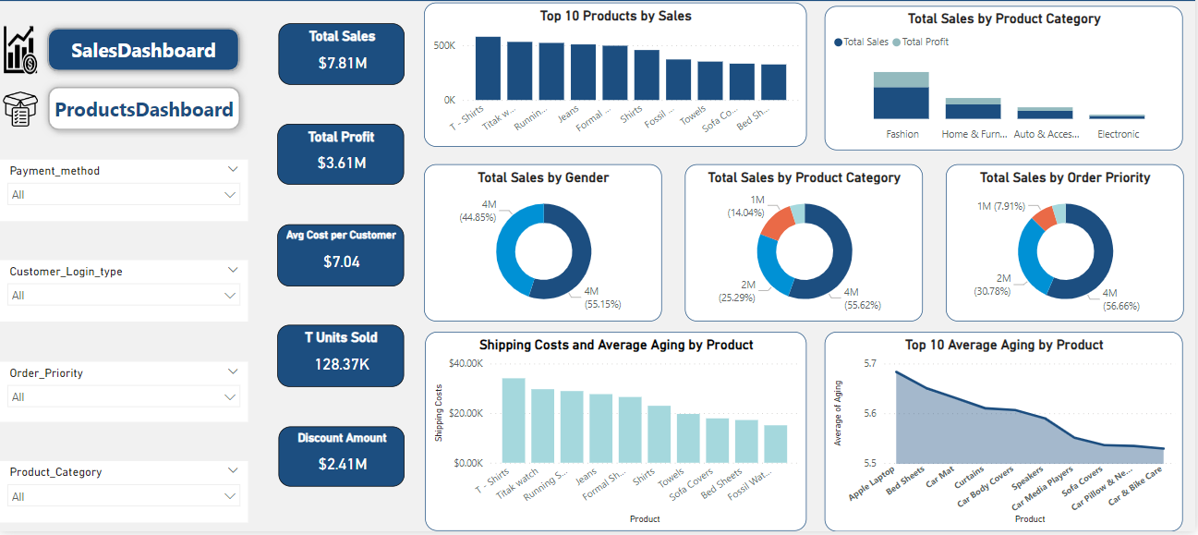
Products Performance Dashboard Analysis

Slide 11
Products Metrics Interpretation
Insight: Strong overall sales performance, indicating healthy demand for products.
Recommendation: Analyze sales trends to identify peak periods and adjust marketing strategies accordingly.
Explore opportunities to expand into new markets or product categories.
$7.81M
Total Sales
Insight: High volume of units sold, suggesting efficient inventory management and popular product selection.
Recommendation: Investigate which specific products are driving unit sales. Consider promotional campaigns or bundles for top-selling items to further boost sales volume.
128.37K
Total Units Sold
$3.61M
Insight: Healthy profit margin, demonstrating effective pricing and cost control strategies.
Recommendation: Analyze profit margins by product category or sales channel to identify areas for optimization. Consider exploring ways to increase average order value to boost profitability.
Total Profit
$2.41M
This indicates a substantial amount spent on discounts. Evaluating the impact of discounts on sales and profitability could help determine if the current discount strategy is effective.
Discount Amount
$7.04
Avg Cost per Customer
This number provides insight into customer acquisition and retention costs. Comparing this to customer lifetime value could help evaluate the effectiveness of marketing and customer service strategies.
Conversion Rate

Slide 12
Sales Channel, Product, and Order Priority Analysis
the overwhelming dominance of web traffic (93.34%) compared to mobile traffic (6.66%)
This indicates that customers heavily prefer using desktop or laptop computers for their purchases.
A chart shows sales distribution across different product categories, with “Fashion” category dominating at (55.62%) and “Home & Furniture” contributing (25.29%). The remaining categories have smaller shares.
Focus marketing and promotional efforts on the top two performing categories to maximize revenue
the distribution of sales by order priority. The majority of orders (56.67%) are placed with “Medium" priority, followed by “High" (30.78%). “Critical" and “Low" priority orders constitute a much smaller percentage of sales.
offering discounts for faster shipping, highlighting the benefits of expedited delivery, or creating a sense of urgency through limited-time offers. Additionally, consider tiered pricing for different shipping speeds to cater to various customer needs.

Slide 13
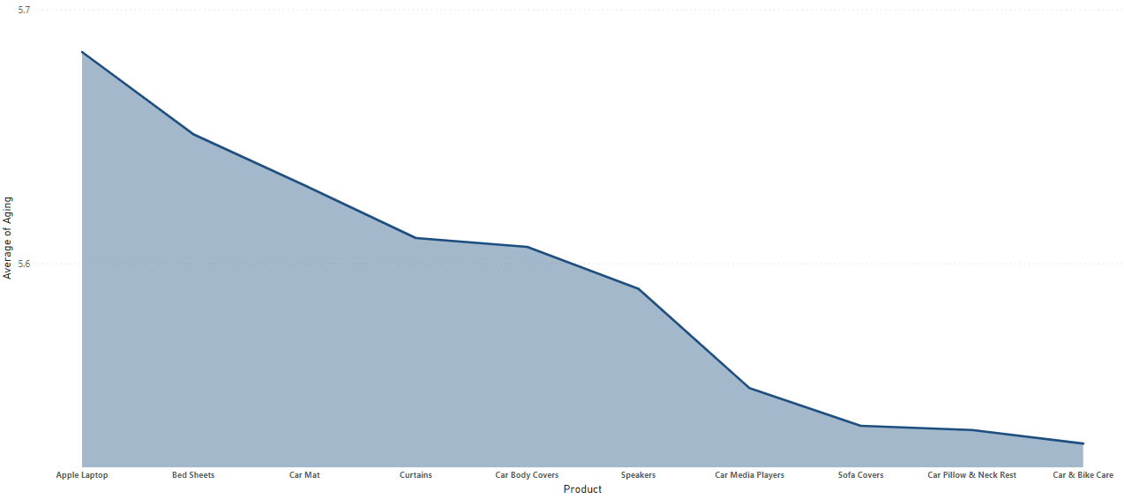
Top 10 Products by Average chipping Time
Insights:
"Apple Laptop" having the highest average aging and "Car & Bike Care" having the lowest
This suggests that Apple laptops are spending the most time in inventory before being sold, while car & bike care products are moving through inventory more quickly.
Recommendations:
To Improve these Shipping Time for these Products I suggest pay attention to inventory of these Products
Push Campaigns to these products to improve the Demand on It

Slide 14
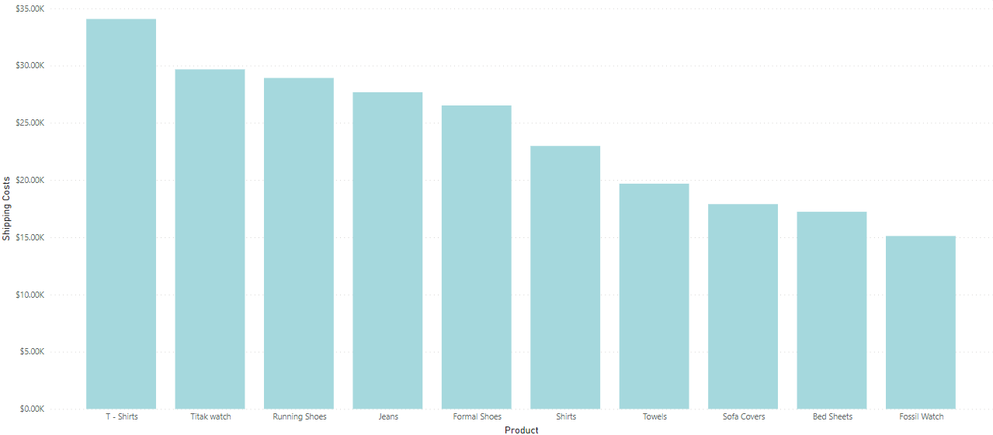
Top 10 Chipping Costs per Product
Insights:
T-shirts incur the highest shipping costs, while Fossil Watches have lowest.
while household Products like towels, sofa covers, and bed sheets have the Moderator chipping costs
Recommendations:
Investigate the reasons behind the high shipping costs for T-shirts (e.g., packaging, weight, carrier rates) and explore options to optimize them.
Consider bundling products with high and low shipping costs to offset expenses and encourage larger orders.
Implement free shipping thresholds or flat-rate shipping for specific product categories to incentivize purchases and streamline shipping costs.

Slide 15


Conclusion
Contoso is a well-known retail company that specializes in offering a wide range of products across various categories, including fashion, home and furniture, auto accessories, and electronics.

Slide 16




Thank you
Abdelrahman Ashour
Senior Data Analyst
abdoashour4040@gmail.com

